Slide 1
ENME601 Thermodynamics
Tutorial Session
Presenter : Dr. Jay Wang

Slide 2
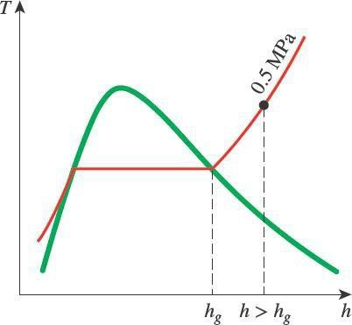
Superheated Vapour Tables
Superheated vapour is characterised by
Lower pressures (𝑃 < 𝑃_{sat} at a given 𝑇)
Higher temperatures (𝑇 > 𝑇_{sat} at a given 𝑃)
Higher specific volumes (𝑣 > 𝑣_{𝑔} at a given 𝑃 or 𝑇)
Higher internal energies (𝑢 > 𝑢_{𝑔} at a given 𝑃 or 𝑇)
Higher enthalpies (ℎ > ℎ_{𝑔} at a given 𝑃 or 𝑇)
Figure 4–39: At a specified P, superheated vapour exists at a higher h than the saturated vapour

Slide 3
Compressed Liquid
When the pressure is greater than 𝑃_{𝑠𝑎𝑡} for a substance at some temperature 𝑇
then it is in the compressed liquid condition.
At very high pressures (not common) Table A7 can be used.
At lower pressures the properties of the compressed liquid are relatively independent of the pressure but strongly dependent on the temperature.
As an approximation we can treat a compressed liquid like a saturated liquid at the same temperature.
So, for any property 𝑦 (= 𝑣, 𝑢, ℎ, 𝑠) for a compressed liquid at some pressure 𝑃 and temperature 𝑇, its value can be taken as the saturated liquid value of that property at temperature 𝑇:
𝑦 ≈ 𝑦_{𝑓@𝑇}
For enthalpy ℎ a more accurate approximation can be used. (We will use the above approximation).
ℎ ≈ ℎ_{𝑓@ 𝑇} + 𝑣_{𝑓} 𝑃 − 𝑃_{sat}

Slide 4
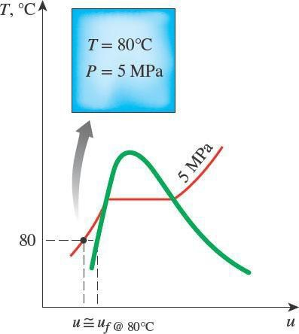
Compressed Liquid
Compressed liquids are characterised by:
Higher pressures (𝑃 > 𝑃_{sat} at a given 𝑇)
Lower temperatures (𝑇 < 𝑇_{sat} at a given 𝑃)
Lower specific volumes (𝑣 ≤ 𝑣_{𝑓} at a given 𝑃 and 𝑇)
Lower internal energies (𝑢 ≤ 𝑢_{𝑓} at a given 𝑃 and 𝑇)
Lower enthalpies (ℎ ≤ ℎ_{𝑓} at a given 𝑃 and 𝑇)
For a compressed liquid at a given temperature, 𝑇
and pressure, 𝑃 :
𝑣 = 𝑣_{𝑓} at temperature 𝑇 (table A-4)
𝑢 = 𝑢_{𝑓} at temperature 𝑇 (table A-4)
ℎ = ℎ_{𝑓} at temperature 𝑇 (table A-4)
Figure 4–41: A compressed liquid state on a 𝑇 − 𝑢 diagram

Slide 5
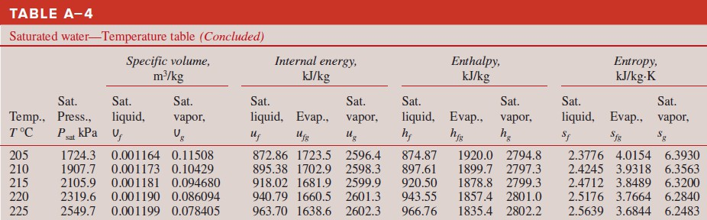
Interpolation (1)
𝐅𝐢𝐧𝐝 𝐏_{𝐬𝐚𝐭} 𝐚𝐭
𝐓 = 𝟐𝟎𝟖℃?
Steam tables don’t list the properties for every possible temperature/pressure.
Use interpolation method to find values for temperatures fall between the table entries.
Assuming between 2 known points.
linear relationship

Slide 6
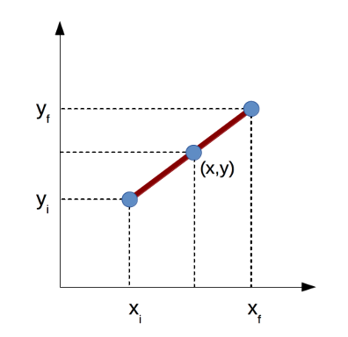
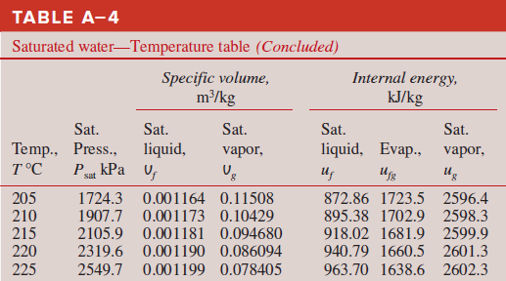
Interpolation (2) Example: 𝐅𝐢𝐧𝐝 𝐏_{𝐬𝐚𝐭} 𝐚𝐭 𝐓 = 𝟐𝟎𝟖℃?
𝑦₂
𝑦₁
𝑥₁
𝑥₂
Take two
nearest
table entries
Temp, ℃ | P_{sat}, kPa
205 (T₁) | 1724.3 (P₁)
208 (T) | ? (P)
210 (T₂) | 1907.7 (P₂)
𝑥 − 𝑥₁ ₌ 𝑦 − 𝑦₁
𝑥₂ − 𝑥₁ 𝑦₂ − 𝑦₁

Slide 7

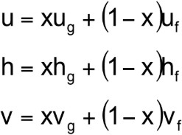


QUALITY (DRYNESS FRACTION)
or

Slide 8
Tutorial Questions (Week 3) Q1-Q8 Guidelines

Slide 9
Tutorial Question Q1
Q1) Find the saturation pressure for water if its temperature is measured to be 100°C. Also, find the specific volume, enthalpy, and internal energy for the saturated liquid at this temperature.
Use Table A4

Slide 10
Tutorial Question Q2
Q2) Find the saturation temperature for R-134a if its pressure is measured to be 500 kPa. Also, find the specific volume, enthalpy, and internal energy of the saturated vapour at this pressure.
Use Table A-12

Slide 11
Tutorial Question Q3
Q3) The temperature in a vessel filled with water is measured to be 222.5°C. Using the interpolation method, find the saturation pressure at this temperature.
Use Table A4, and then Interpolate

Slide 12
Tutorial Question Q4
Q4) A container is filled with superheated steam at a pressure of 0.3 MPa and a temperature of 325°C. Determine the steam’s specific volume, specific internal energy, and specific enthalpy.
Use Table A6, and the interpolate (due to 325$℃$)

Slide 13
Tutorial Question Q5
Q5) The temperature in a container filled with saturated water is measured to be 90°C. Determine its quality if the water has a specific volume of 2 m³/kg.
Use Table A4, to find out V_{f} and V_{g} (at 90 °C)

Slide 14
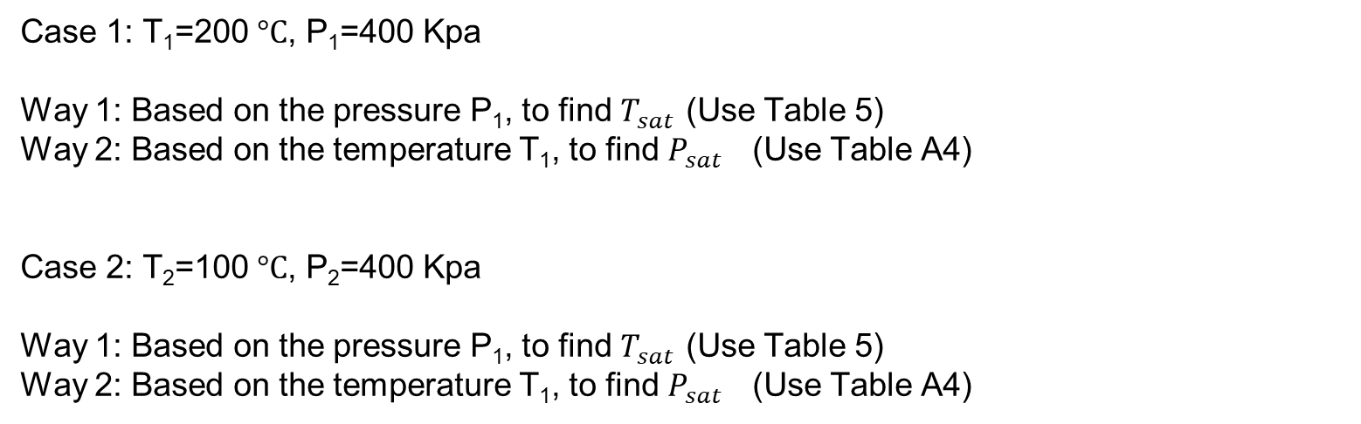
Tutorial Question Q6
Q6) The temperature of water in a piston–cylinder is measured to be 200°C, and its pressure is measured to be 400 kPa. Determine which phase the water is in, and which table should be used to find its properties. What table should be used if the pressure is maintained at 400 kPa, but the temperature is lowered to 100°C?
Superheated vapour is characterised by
Lower pressures (𝑃 < 𝑃_{sat} at a given 𝑇)
Higher temperatures (𝑇 > 𝑇_{sat} at a given 𝑃)
Higher specific volumes (𝑣 > 𝑣_{𝑔} at a given 𝑃 or 𝑇)
Higher internal energies (𝑢 > 𝑢_{𝑔} at a given 𝑃 or 𝑇)
Higher enthalpies (ℎ > ℎ_{𝑔} at a given 𝑃 or 𝑇)
Case 1: T₁=200 $°C$, P₁=400 Kpa
Way 1: Based on the pressure P₁, to find $T_{sat }$(Use Table 5)
Way 2: Based on the temperature T₁, to find $P_{sat }$ (Use Table A4)
Case 2: T₂=100 $°C$, P₂=400 Kpa
Way 1: Based on the pressure P₁, to find $T_{sat }$(Use Table 5)
Way 2: Based on the temperature T₁, to find $P_{sat }$ (Use Table A4)
Compressed liquids are characterised by:
Higher pressures (𝑃 > 𝑃_{sat} at a given 𝑇)
Lower temperatures (𝑇 < 𝑇_{sat} at a given 𝑃)
Lower specific volumes (𝑣 ≤ 𝑣_{𝑓} at a given 𝑃 and 𝑇)
Lower internal energies (𝑢 ≤ 𝑢_{𝑓} at a given 𝑃 and 𝑇)
Lower enthalpies (ℎ ≤ ℎ_{𝑓} at a given 𝑃 and 𝑇)

Slide 15
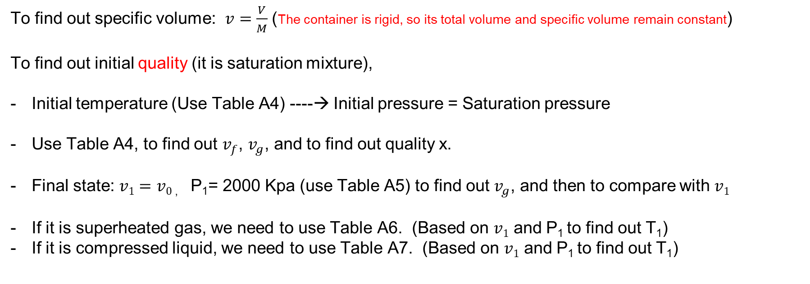
Tutorial Question Q7
Q7) 10 kg of water fills a 1.115 m³ rigid container at an initial temperature of 150°C. The container is then heated until the pressure is 2000 kPa. Determine the initial pressure and quality, and the final temperature.
To find out specific volume: $v=\frac{V}{M}$ (The container is rigid, so its total volume and specific volume remain constant)
To find out initial quality (it is saturation mixture),
Initial temperature (Use Table A4) ----→ Initial pressure = Saturation pressure
Use Table A4, to find out $v_{f}$, $v_{g}$, and to find out quality x.
Final state: $v1=v0$ , P₁= 2000 Kpa (use Table A5) to find out $v_{g}$, and then to compare with $v1$
If it is superheated gas, we need to use Table A6. (Based on $v1$ and P₁ to find out T₁)
If it is compressed liquid, we need to use Table A7. (Based on $v1$ and P₁ to find out T₁)

Slide 16
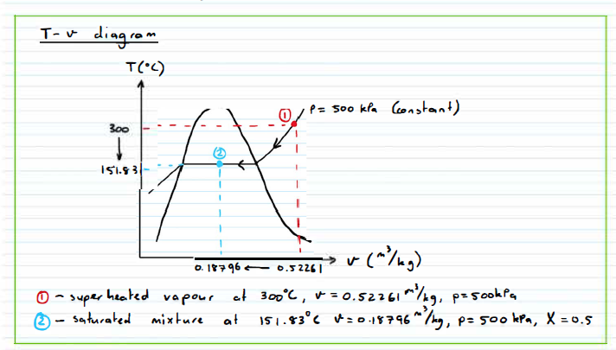
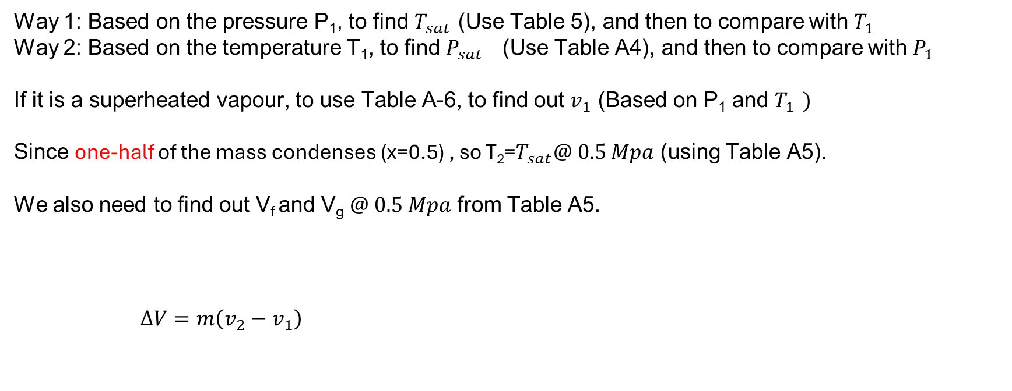
Tutorial Question Q8
Q8) A piston-cylinder device contains 0.6 kg of steam at 300°C and 0.5 MPa. The steam is cooled at a constant pressure until one-half of the mass condenses. Show the process on a T-v diagram, find the final temperature, and determine the volume change.
Way 1: Based on the pressure P₁, to find $T_{sat }$(Use Table 5), and then to compare with $T_{1 }$
Way 2: Based on the temperature T₁, to find $P_{sat }$ (Use Table A4), and then to compare with $P_{1 }$
If it is a superheated vapour, to use Table A-6, to find out $v_{1}$ (Based on P₁ and $T_{1 })$
Since one-half of the mass condenses (x=0.5) , so T₂=$T_{sat}@ 0.5 Mpa$ (using Table A5).
We also need to find out V_{f} and V_{g} $@ 0.5 Mpa$ from Table A5.
$$∆V=m\left(v_{2}−v_{1}\right)$$

